Slide 1
Random Forest Classifier
Jayaraj P B
1

Slide 2
Outline
Decision Tree – Recap
Random Forest Classifier – Overview
Bagging & Boosting
Working of Random Forest Algorithm
Case Study Application – Drug Discovery

Slide 3
Decision trees
Non-linear classifier
Easy to use
Easy to interpret
Susceptible to overfitting but can be
avoided.

Slide 4
Decision tree structure

Slide 5
Disadvantages of the Decision Tree
The decision tree contains lots of layers, which makes it complex.
It may have an overfitting issue, which can be resolved using the Random Forest algorithm.
For more class labels, the computational complexity of the decision tree may increase.

Slide 6
wisdom of the crowd
Suppose you ask a complex question to thousands of random people, then aggregate their answers. In many cases you will find that this aggregated answer is better than an expert’s answer. This is called the wisdom of the crowd.
Similarly, if you aggregate the predictions of a group of predictors (such as classifiers or regressors), you will often get better predictions than with the best individual predictor. A group of predictors is called an ensemble; thus, this technique is called Ensemble Learning

Slide 7
Voting Classifiers
Suppose you have trained a few classifiers, each one achieving about 80% accuracy.
You may have a Logistic Regression classifier, an SVM classifier, a Random Forest classifier, a K-Nearest Neighbors classifier, and perhaps a few more

Slide 8
Hard voting classifier
A very simple way to create an even better classifier is to aggregate the predictions of each classifier and predict the class that gets the most votes. This majority-vote classifier is called a hard voting classifier

Slide 9
Somewhat surprisingly, this voting classifier often achieves a higher accuracy than the best classifier in the ensemble.
In fact, even if each classifier is a weak, the ensemble can still be a strong learner (achieving high accuracy), provided there are a sufficient number of weak learners and they are sufficiently diverse.
How is this possible?
This is due to the law of large numbers(LLN)
Law of Large Numbers is a concept in probability and statistics that states that the average is closer to the expected or theoretical value as the number of trials or observations increases.

Slide 10
Bagging and Pasting
One way to get a diverse set of classifiers is to use very different training algorithms, as just discussed.
Another approach is to use the same training algorithm for every predictor, but to train them on different random subsets of the training set.
When sampling is performed with replacement, this method is called bagging (short for bootstrap aggregating2).
When sampling is performed without replacement, it is called pasting.

Slide 11
Training set sampling and training
In other words, both bagging and pasting allow training instances to be sampled several times across multiple predictors, but only bagging allows training instances to be sampled several times for the same predictor

Slide 12
Lower Variance for Ensemble
Once all predictors are trained, the ensemble can make a prediction for a new instance by simply aggregating the predictions of all predictors. The aggregation function is typically the statistical mode for classification, or the average for regression.
The individual predictor has a higher bias than if it were trained on the original training set, but aggregation reduces both bias and variance.
Generally, the net result is that the ensemble has a similar bias but a lower variance than a single predictor trained on the original training set.

Slide 13
Predictors can all be trained in parallel, via different CPU cores or even different servers.
Similarly, predictions can be made in parallel. This is one of the reasons why bagging and pasting are such popular methods: they scale very well.

Slide 14
Ensemble Learning
Ensemble simply means combining multiple models. Thus a collection of models is used to make predictions rather than an individual model.
Ensemble uses two types of methods:
Bagging
It creates a different training subset from sample training data with replacement & the final output is based on majority voting. For example, Random Forest.
Boosting
It combines weak learners into strong learners by creating sequential models such that the final model has the highest accuracy. For example, ADA BOOST, XG BOOST.

Slide 15
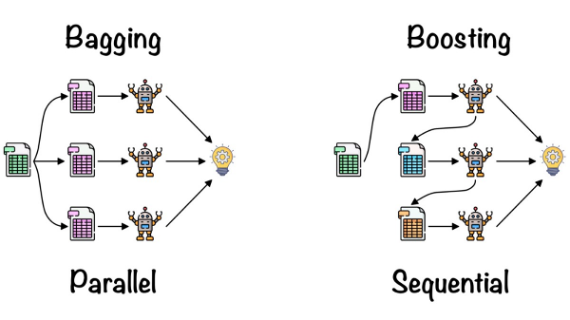
Bagging Vs Boosting

Slide 16
Bagging
Bagging or bootstrap aggregation a technique for reducing the variance of an estimated prediction function.
For classification, a committee of trees each
cast a vote for the predicted class.

Slide 17
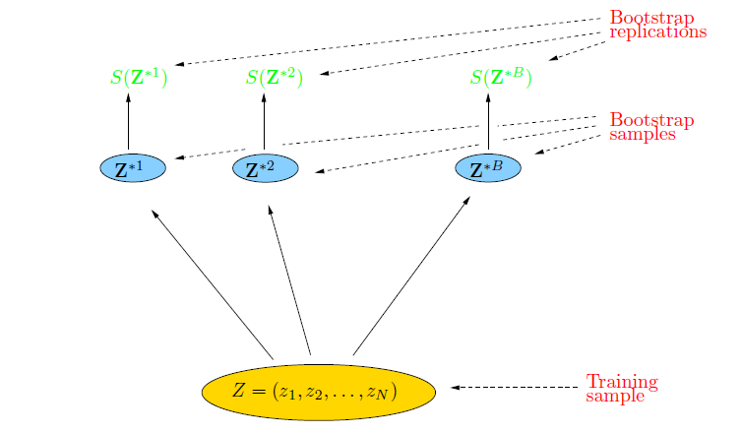
Bootstrap
The basic idea:
randomly draw datasets with replacement from the
training data, each sample the same size as the original training set

Slide 18
Bagging
Bagging, also known as Bootstrap Aggregation, serves as the ensemble technique in the Random Forest algorithm.
Selection of Subset: Bagging starts by choosing a random sample, or subset, from the entire dataset.
Bootstrap Sampling: Each model is then created from these samples, called Bootstrap Samples, which are taken from the original data with replacement. The step of row sampling with replacement is referred to as bootstrapping.
Independent Model Training: Each model is trained independently on its corresponding Bootstrap Sample. This training process generates results for each model.
Majority Voting: The final output is determined by combining the results of all models through majority voting. The most commonly predicted outcome among the models is selected.
Aggregation: This step, which involves combining all the results and generating the final output based on majority voting.

Slide 19
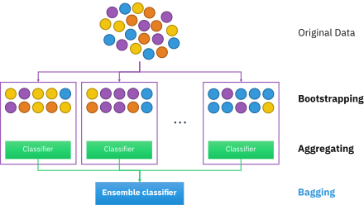

Slide 20
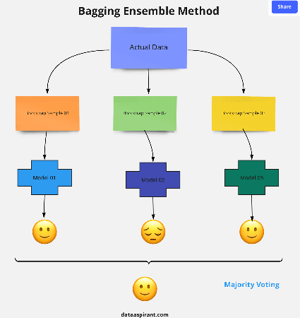

Slide 21
out-of-bag Evaluation
With bagging, some instances may be sampled several times for any given predictor, while others may not be sampled at all. By default a Bagging Classifier samples m training instances with replacement, where m is the size of the training set. This means that only about 63% of the training instances are sampled on average for each predictor.
The remaining 37% of the training instances that are not sampled are called out-of-bag (oob) instances. Note that they are not the same 37% for all predictors
Since a predictor never sees the oob instances during training, it can be evaluated on these instances, without the need for a separate validation set.

Slide 22
Random Patches and Random Subspaces
The Bagging Classifier class supports sampling the features as well. This is controlled by two hyperparameters: max_features and bootstrap_features. They work the same way as max_samples and bootstrap, but for feature sampling instead of instance sampling.
Thus, each predictor will be trained on a random subset of the input features.
This is particularly useful when you are dealing with high-dimensional inputs (such as images). Sampling both training instances and features is called the Random Patches method.
Keeping all training instances but sampling features is called the Random Subspaces method.
Sampling features results in even more predictor diversity, trading a bit more bias for a lower variance.

Slide 23
For example, you can train a group of Decision Tree classifiers, each on a different random subset of the training set. To make predictions, you just obtain the predictions of all individual trees, then predict the class that gets the most votes.
Such an ensemble of Decision Trees is called a Random Forest, and despite its simplicity, this is one of the most powerful Machine Learning algorithms

Slide 24
Feature Importance
Yet another great quality of Random Forests is that they make it easy to measure the relative importance of each feature. Scikit-Learn measures a feature’s importance by looking at how much the tree nodes that use that feature reduce impurity on average(across all trees in the forest).
More precisely, it is a weighted average, where each node’s weight is equal to the number of training samples that are associated with it

Slide 25
Greater tree diversity in RF
A Random Forest is an ensemble of Decision Trees, generally trained via the bagging method (typically with max_samples set to the size of the training set).
The Random Forest algorithm introduces extra randomness when growing trees; instead of searching for the very best feature when splitting a node, it searches for the best feature among a random subset of features.
This results in a greater tree diversity, which trades a higher bias for a lower variance, generally yielding an overall better model.

Slide 26
Random Forest
Random forest is a commonly-used machine learning algorithm trademarked by Leo Breiman and Adele Cutler, which combines the output of multiple decision trees to reach a single result.
It is based on the concept of ensemble learning, which is a process of combining multiple classifiers to solve a complex problem and to improve the performance of the model.

Slide 27
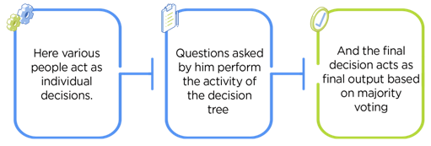
Real-Life Analogy of Random Forest
A student named X wants to choose a course after his 10+2, and he is confused about the choice of course based on his skill set. So he decides to consult various people like his cousins, teachers, parents, degree students, and working people. He asks them varied questions like why he should choose, job opportunities with that course, course fee, etc. Finally, after consulting various people about the course he decides to take the course suggested by most people.

Slide 28
History of Random Forests
Introduction of the Random Subspace Method
“Random Decision Forests” [Ho, 1995] and “The Random Subspace Method for Constructing Decision Forests” [Ho, 1998]
Combined the Random Subspace Method with Bagging. Introduce the term Random Forest (a trademark of Leo Breiman and Adele Cutler)
“Random Forests” [Breiman, 2001]

Slide 29
RF - Introduction
Random Forests can be regarded as ensemble learning with decision trees
Instead of building a single decision tree and use it to make predictions, build many slightly different trees . Combine their predictions using majority voting
The main two concepts behind random forests are:
The wisdom of the crowd — a large group of experts are collectively smarter than individual experts
Diversification — a set of uncorrelated tress
A supervised machine learning algorithm

Slide 30
Random Forest Model

Slide 31
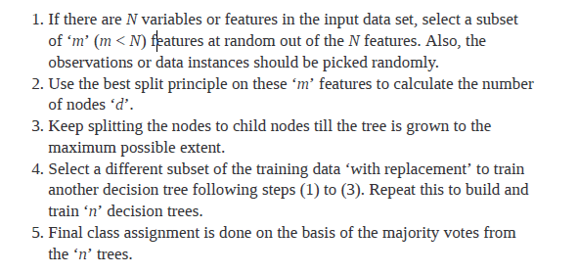
How does random forest work?

Slide 32
Random Forest
As explained earlier, Random Forest (RF) is a committee of weak learners for solving prediction problems.
In RF, a decision tree, CART (Classification And Regression Tree) is used as a weak learner.
CART follows greedy, top-down binary, recursive partitioning, that divides feature space into sets of disjoint rectangular regions.
Each internal node has an associated splitting predicate.
32

Slide 33
Random Forest Classifier
Training Data
M features
N examples
Notes:
As the classifier of choice we adopt Random Forest Classifier, due to its robustness to heterogenous and noisy feature.
Random Forest is an ensembe classifier. Briefly, given N data and M features, bootsrap samples are created from the traning data

Slide 34
Random Forest Classifier
Create bootstrap samples
from the training data
M features
N examples
....…

Slide 35
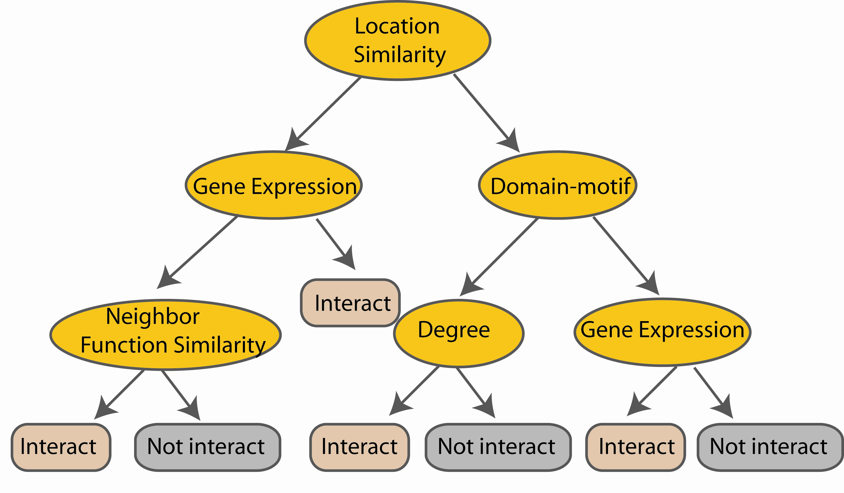
Random Forest Classifier
Construct a decision tree
M features
N examples
....…
Notes:
From eachd descision tree .. In spliting the nodes, the Gini Gain is employed

Slide 36

Random Forest Classifier
At each node in choosing the split feature
choose only among m<M features
M features
N examples
....…
Notes:
Different from the regular decision trees in random forest, when the splitting feature is chosen from only a subset of allf eatures.
The robostness of the classifier arises from
bootsraping of the training data and the random selection of features, the the random choose of features.

Slide 37

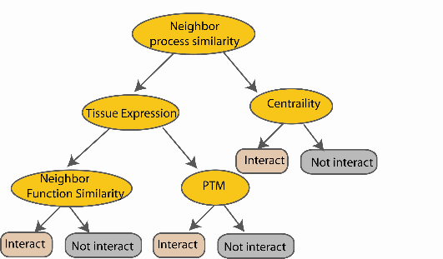
Random Forest Classifier
Create decision tree
from each bootstrap sample
M features
N examples
....…
....…

Slide 38
Random Forest Classifier
M features
N examples
Take he majority vote
....…
....…
Notes:
Finally the given an input data the decision is made as follows given an input data,

Slide 39
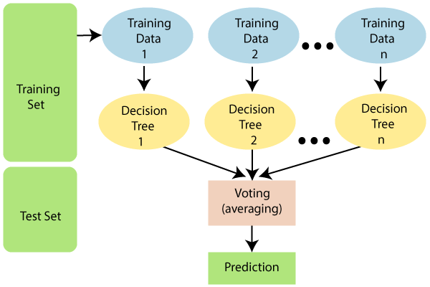
The greater number of trees in the forest leads to higher accuracy and prevents the problem of overfitting.

Slide 40
Important Features of Random Forest
Diversity: Not all attributes/variables/features are considered while making an individual tree; each tree is different.
Immune to the curse of dimensionality: Since each tree does not consider all the features, the feature space is reduced.
Parallelization: Each tree is created independently out of different data and attributes. This means we can fully use the CPU to build random forests.
Train-Test split: In a random forest, we don’t have to segregate the data for train and test as there will always be 30% of the data which is not seen by the decision tree.
Stability: Stability arises because the result is based on majority voting/ averaging.

Slide 41
Hyperparameters in Random Forest
Hyperparameters to Increase the Predictive Power
n_estimators: Number of trees the algorithm builds before averaging the predictions.
max_features: Maximum number of features random forest considers splitting a node.
mini_sample_leaf: Determines the minimum number of leaves required to split an internal node.
criterion: How to split the node in each tree? (Entropy/Gini impurity/Log Loss)
max_leaf_nodes: Maximum leaf nodes in each tree

Slide 42
Advantages
It can be used in classification and regression problems.
It solves the problem of overfitting as output is based on majority voting or averaging.
It performs well even if the data contains null/missing values.
Each decision tree created is independent of the other; thus, it shows the property of parallelization.
It is highly stable as the average answers given by a large number of trees are taken.
It maintains diversity as all the attributes are not considered while making each decision tree though it is not true in all cases.
It is immune to the curse of dimensionality. Since each tree does not consider all the attributes, feature space is reduced.
We don’t have to segregate data into train and test as there will always be 30% of the data, which is not seen by the decision tree made out of bootstrap.

Slide 43
Disadvantages
Random forest is highly complex compared to decision trees, where decisions can be made by following the path of the tree.
Training time is more than other models due to its complexity. Whenever it has to make a prediction, each decision tree has to generate output for the given input data.

Slide 44
Application of Random Forest in Computer aided Drug Discovery

Slide 45
Introduction to Drug Discovery
Drug discovery is an inventive process of developing a new drug which will be therapeutically active to a disease causing target molecule
Target : is a key molecule that is specific to a disease condition.
Ligand : a small molecule that will bind tightly to its target. This binding results in a change of conformation of the target.
It deals with design of molecule that is complementary in charge and shape to the target to which it binds
45

Slide 46
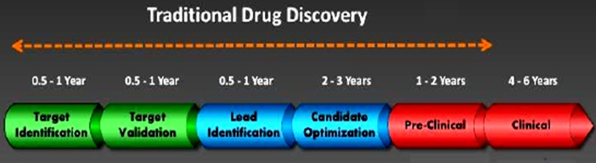
Traditional Drug discovery pipeline
Requires lot of wet lab experiments with target and large no of molecules
Large exploration space need large execution time and money
Image Courtesy : www.cresset-group.co

Slide 47
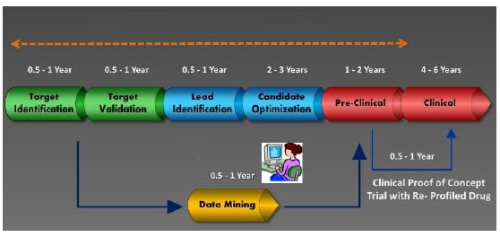
Computer aided Drug Discovery
Image Courtesy : www.cresset-group.co
Breaks the bottleneck by using modern computational techniques
Machine learning, artificial intelligence.
It can avoid costly wet-lab experimentations

Slide 48
Virtual Screening
Virtual Screening(VS) is a computational technique used in drug discovery for evaluating large number of molecules to identify lead molecules that can be optimized to give a drug candidate.
Because of VS only, the drug discovery consider enormous chemical space of over 10⁶⁰ conceivable compounds for screening.
This will speed up the Drug discovery process while reducing the need for expensive wet lab work.
48

Slide 49
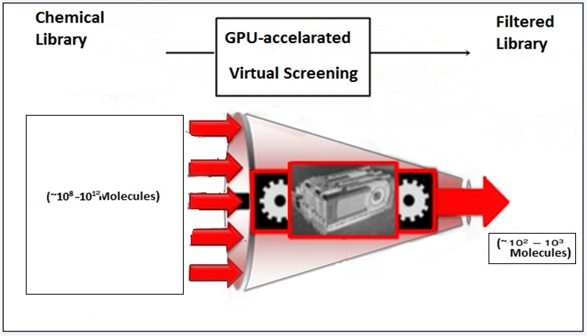
GPU accelerated Virtual Screening
49

Slide 50
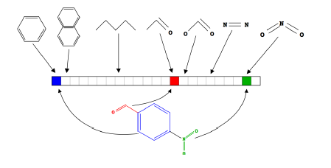
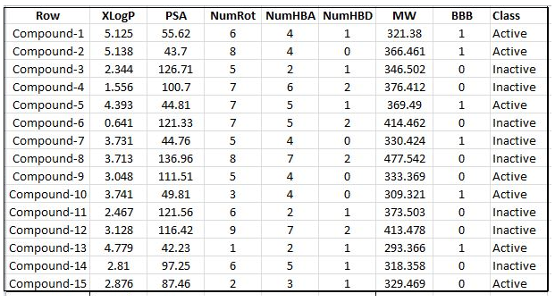
Molecule as a vector
Proposed Method1
A molecule can be
represented as a
set of descriptors
179 descriptors are
considered in the
proposed work
A molecule can
be considered as a
point in a
multidimensional
‘descriptor space’.
Image Courtesy : www.cresset-group.co
50

Slide 51
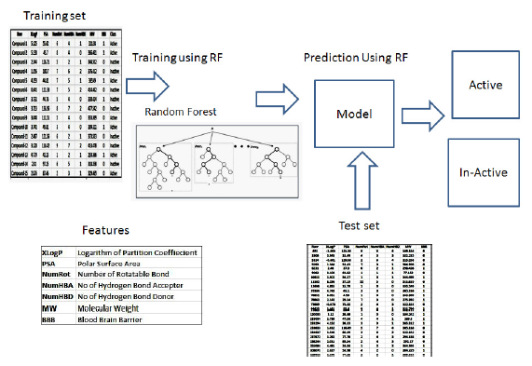
RF Classifier for LBVS
Proposed Method1
51
Issues: Model creation and prediction serially for millions of molecules takes too much of time to complete the VS process.

Slide 52
Parallel Decision Tree construction
To grow a decision tree on GPU, a hybrid method is developed in the proposed work.
Hybrid method uses combination of depth first and breadth first constructions
Depth First tree construction is utilized at tree top.
Tree construction will switch to breadth first tree construction after a threshold value.
This cross over threshold can be set by the number of nodes grown in the tree.
52

Slide 53
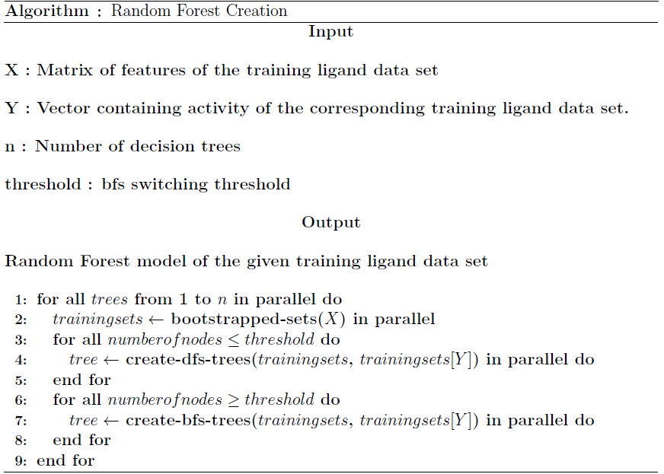
Proposed Parallel Training Algorithm

Slide 54
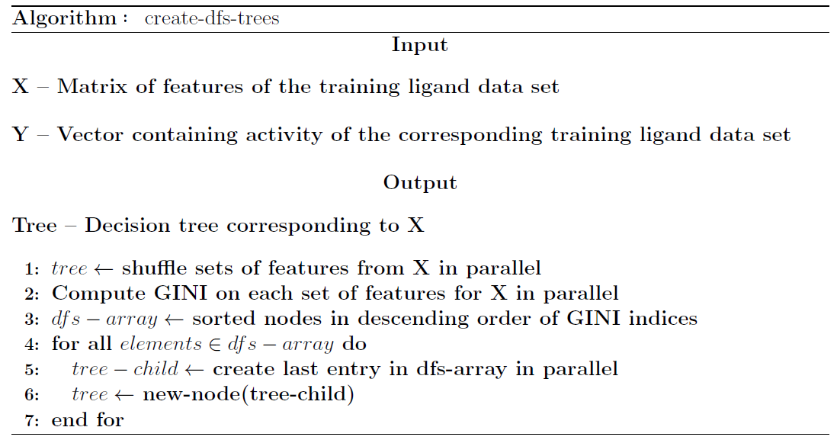
Proposed Parallel Training Algorithm Continued…

Slide 55
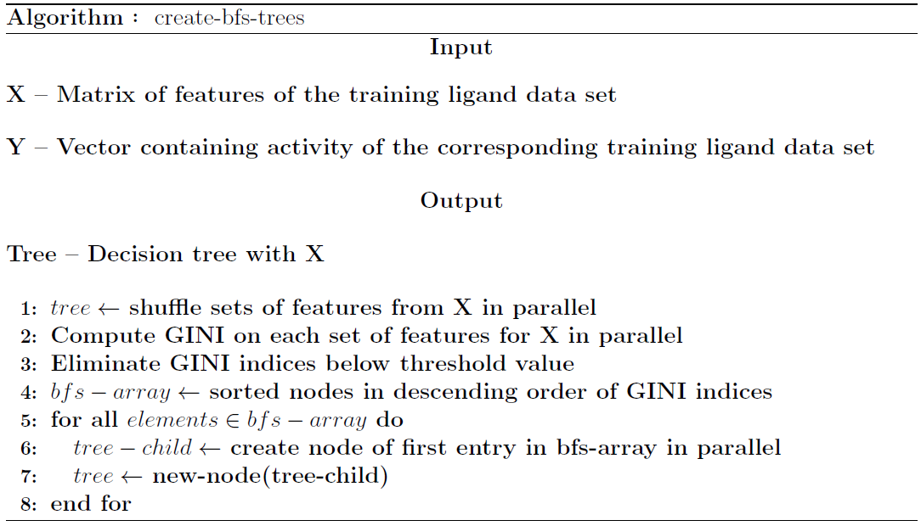
Proposed Parallel Training Algorithm

Slide 56
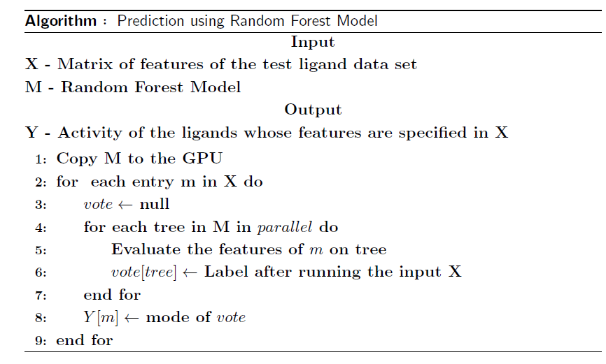
Proposed Parallel Prediction Algorithm
Proposed Method1

Slide 57
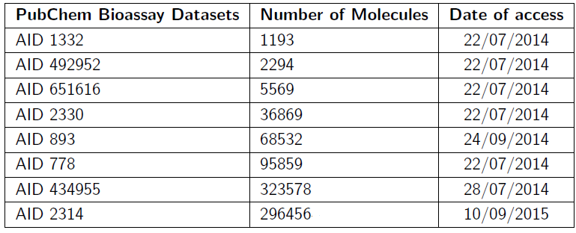
Data set used
57
Input – Bio-assay SDF file from NCBI PubChem[34]
Feature Extraction Tool Used : POWERMV[32]
- 179 descriptors are generated for each data set[4]
9/3/2024
57

Slide 58
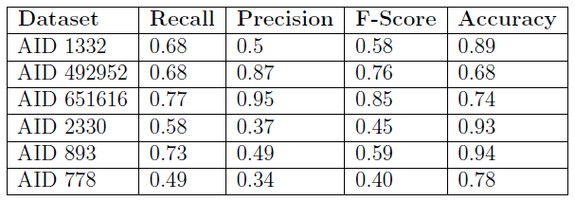
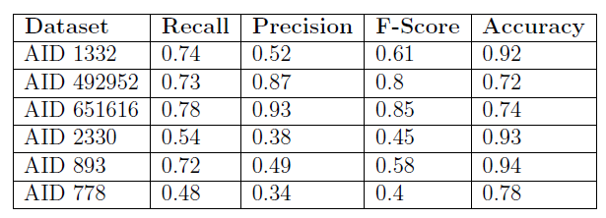
Performance [serial and parallel]
58
Serial
Parallel
9/3/2024
58

Slide 59
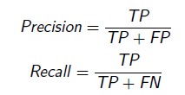



Slide 60
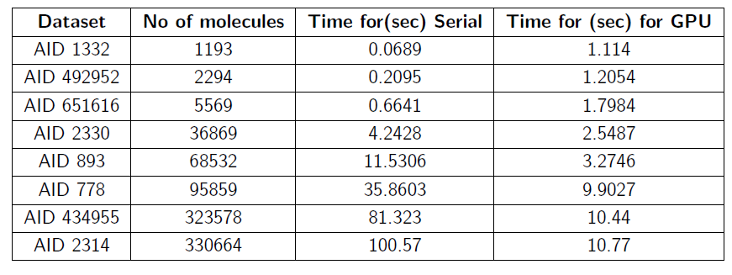
Speed up in Training
Proposed Method1
60
For smaller data set, the speedup is less due to the overhead in CPU-GPU data transfer.
For Larger data set, there is a visible computational boost of 10 fold.
9/3/2024
60

Slide 61
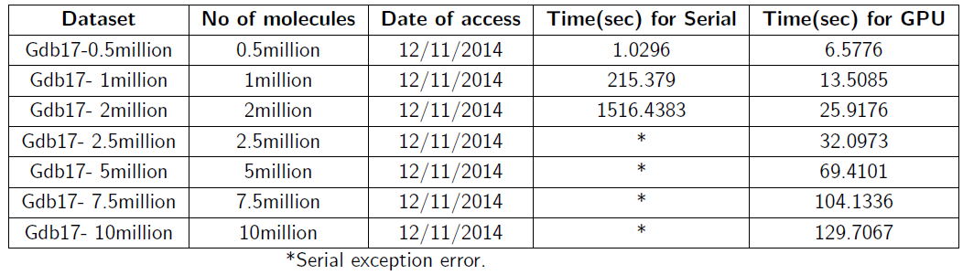
Speed up in Prediction
61
The data set for classification were taken from GDB17[35],
a chemical universal database for unknown compounds.
Speedup of 5 – 60 times is achieved
9/3/2024
61

Slide 62
